Slide 1
Partial Orders (POSETs)

Slide 2
Partial order or POSET
Definitions:
  A relation R on a set A is called a partial order if it is
    Reflexive
    Antisymmetric
    Transitive
  set A together with a partial ordering R is called a partially ordered set (poset, for short) and is denote by [A;R]
    A is partially ordered by the relation R
If a transitive relation is irreflexive and asymmetric (a strong partial
order),

Slide 3
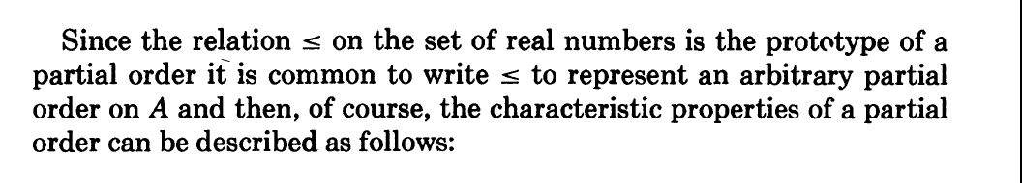
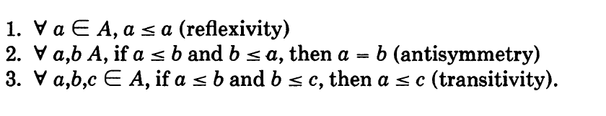

Slide 4
Example
  The relation “less than or equal to” over the set of integers (Z; ≤) since for every a,b∈Z, it must be the case that a≤b or b≤a
  ≤ is a Poset
  What happens if we replace ≤ with <?
    Is < Poset?
The relation < is not reflexive, and (Z,<) is not a poset

Slide 5
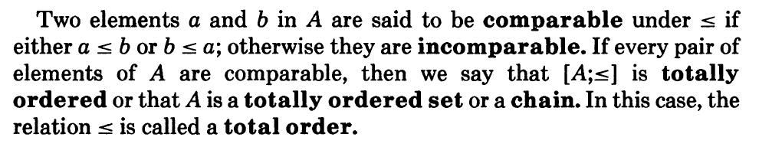
Total Order

Slide 6
Poset or Hasse Diagrams
Like relations and functions, partial orders have a convenient graphical representation: Hasse Diagrams
  Consider the digraph representation of a partial order
  Because we are dealing with a partial order, we know that the relation must be reflexive and transitive
  Thus, we can simplify the graph as follows
    Remove all self loops
    Remove all transitive edges
    Remove directions on edges assuming that they are oriented upwards
  The resulting diagram is far simpler

Slide 7
Hasse Diagram: Example
a₄
a₅
a₄
a₅
a₂
a₂
a₃
a₃
a₁
a₁

Slide 8
Hasse Diagrams: Example (1)
Of course, you need not always start with the complete relation in the partial order and then trim everything.
Rather, you can build a Hasse Diagram directly from the partial order
Example: Draw the Hasse Diagram for the following partial ordering: {(a,b) | a|b } on the set {1, 2, 3, 4, 5, 6, 10, 12, 15, 20, 30, 60}

Slide 9
Hasse Diagram: Example (2)
60
12
20
30
4
6
10
15
2
3
5
1

Slide 10
Least & Greatest Elements
An element b ∈ B is called the least element of B if b < x for all x ∈ B. The set B can have at most one least element. For if b and b’ were two least elements of B, then we would have b < b' and b' < b.
Hence, by antisymmetry b = b‘.
An element b ∈ B is called the greatest element of B if x < b for all x ∈ B. The set B can have at most one greatest element.

Slide 11
Least & Greatest Elements
A= {2,6,3,8,15,27}
Then least element is 2 and greatest element is 27

Slide 12
Lower and Upper bounds
An element b ∈ A is called a lower bound of B if b ≤ x for all x ∈ B.
An element b ∈ A is called a upper bound of B if b ≥ x for all x ∈ B.
If the set of lower bounds of B has a greatest element then this element is called the greatest lower bound (or glb) of B;
similarly, if the set of upper bounds of B has a least element then this element is called the least upper bound (or lub) of B.

Slide 13
Examples
The lower bounds of S = {{a, b, c}, {b, c}} are
{b}, {c}, {b, c} and ∅, . There are no others.
Of the lower bounds of S, greatest lower bound is
{b, c}
In general, when A, B are sets,
  glb {A, B} = A ∩ B

Slide 14
Examples
Within the poset P{a, b, c}, the upper bounds of S = {{a}, {b}} are
{a, b} and {a, b, c}.
Of the upper bounds of S, the least upper bound is
{a, b}
In general, when A, B are sets,
lub = {A, B} = A ∪ B

Slide 15
Extremal Elements: Example 1
Give lower/upper bounds & glb/lub of the sets:
{d,e,f}, {a,c} and {b,d}
{d,e,f}
Lower bounds: ∅, thus no glb
Upper bounds: ∅, thus no lub
{a,c}
g
h
i
Lower bounds: ∅, thus no glb
Upper bounds: {h}, lub: h
d
e
f
{b,d}
Lower bounds: {b}, glb: b
a
b
c
Upper bounds: {d,g}, lub: d because dg
Upper bound {e,b}= {i}
UB{d,b}=

Slide 16
Extremal Elements: Example 2
i
j
f
g
h
Bounds, glb, lub of {c,e}?
  Lower bounds: {a,c}, thus glb is c
  Upper bounds: {e,f,g,h,i,j}, thus lub is e
e
b
c
d
Bounds, glb, lub of {b,i}?
  Lower bounds: {a}, thus glb is c
  Upper bounds: ∅, thus lub DNE
a

Slide 17
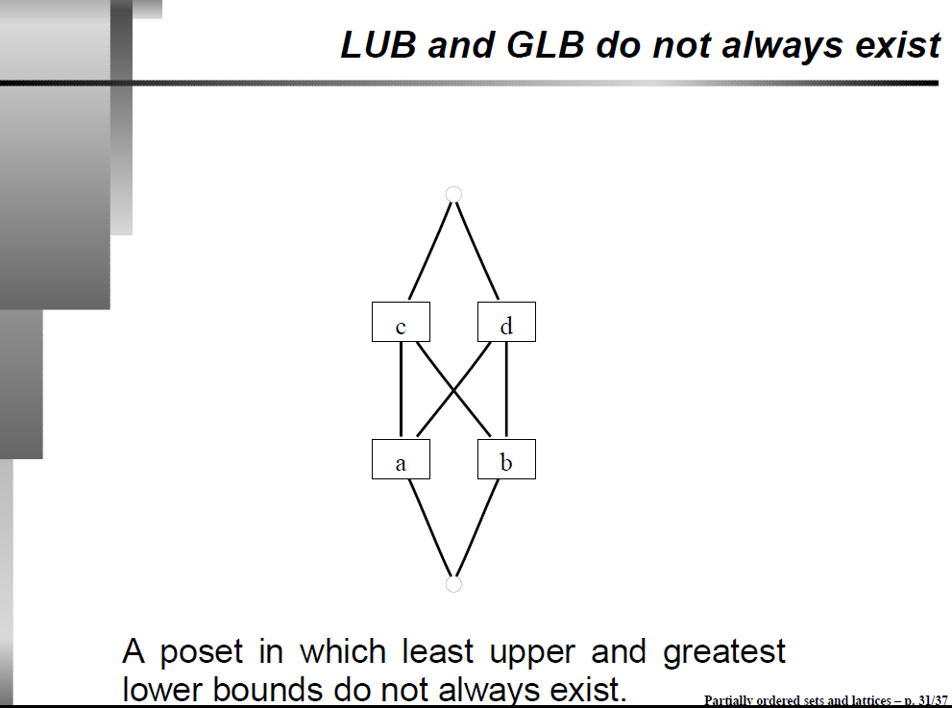

Slide 18
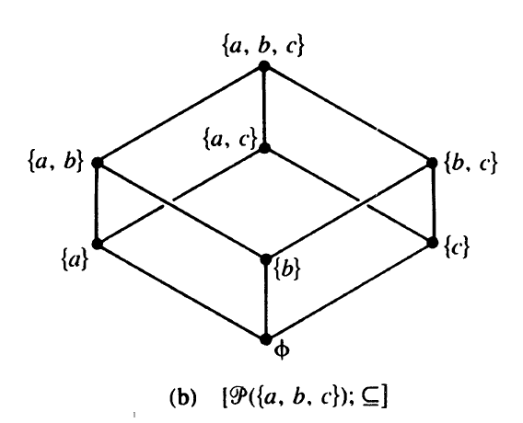
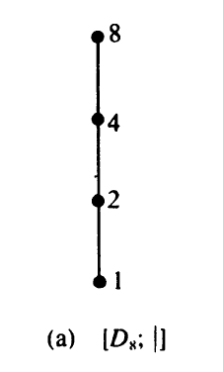
Poset Diagrams

Slide 19
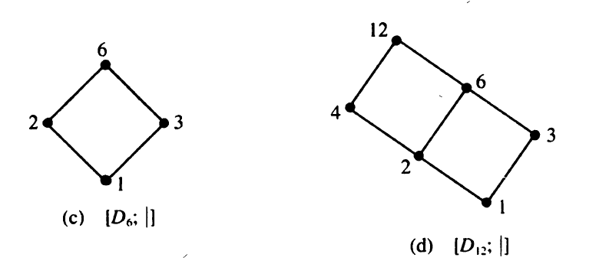
Poset Diagrams

Slide 20
Lattice
A lattice is a poset in which each pair of elements has a least upper bound and a greatest lower bound.

Slide 21
Lattices: Example 1
Is the example from before a lattice?
i
j
f
g
h
No, because the pair {b,c} does not have a least upper bound
e
b
c
d
a

Slide 22
Lattices: Example 2
What if we modified it as shown here?
j
i
f
g
h
Yes, because for any pair, there is an lub & a glb
e
b
c
d
a

Slide 23
A Lattice Or Not a Lattice?
To show that a partial order is not a lattice, it suffices to find a pair that does not have an lub or a glb (i.e., a counter-example)
For a pair not to have an lub/glb, the elements of the pair must first be incomparable (Why?)
You can then view the upper/lower bounds on a pair as a sub-Hasse diagram: If there is no minimum element in this sub-diagram, then it is not a lattice

Slide 24
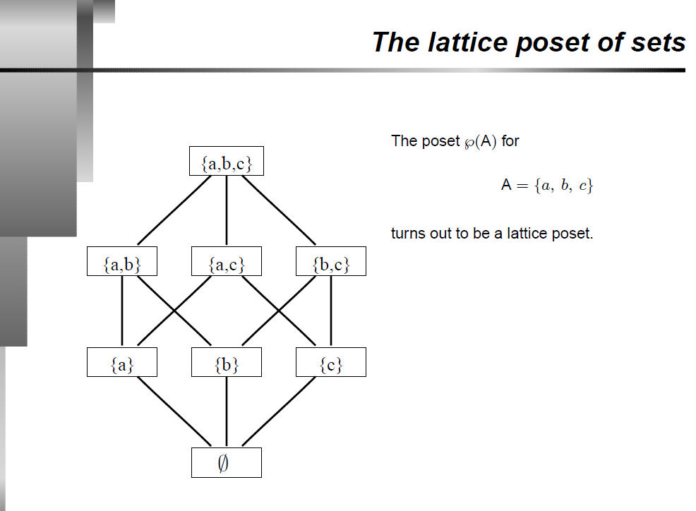

Slide 25
means any elements to be related, it must have a common point and have equal distance travelled or say equal relation present....just a general example?—No
For {e,b} wouldn't the upper bound be i and g ?---Yes

Slide 26
Disclaimer
This Presentation is adapted from some online resources and is solely used for academic purpose.

